Slide 1
Relaxation Labelling using Initial probabilities from Maximum Likelihood
Megh Shukla
173310008
ASIP
MTech CSRE, IIT Bombay

Slide 2
Maximum Likelihood
Based on the Bayesian Equation, find probability of pixel belonging to a class given the Class
Prior probability of Classes assumed equal
Classes assumed to have Gaussian Distribution, with unequal Means and Variances

Slide 3
RELAXATION LABELLING
Implements the idea of Context
Uses a 3x3 neighbourhood support to establish the probabilities for the given pixel
Compatibility Matrix used to determine degree of support between classes
Neighbours assumed to have equal weightage (influence on centre pixel)

Slide 4
Project
Compute Maximum Likelihood and Relaxation Labelling for Satellite Imagery
Six classes : Water, Forest, Grassland, Barren Land, Urban, Shadows
Each pixel in image associated with probabilities corresponding to the six classes
These values form the initial probability for Relaxation Labelling
In the Relaxation Labelling phase, for each centre pixel it’s 3x3 neighbourhood is considered
Influence of pixel class probabilities of neighbours determines final set of class probabilities for target pixel

Slide 5
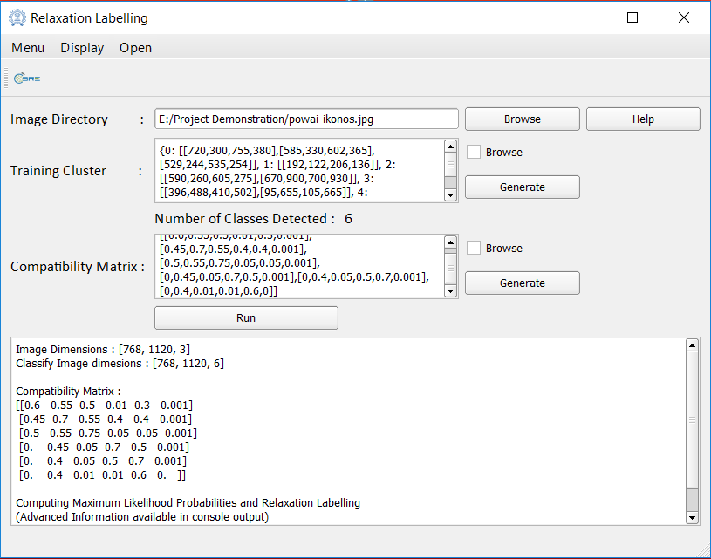
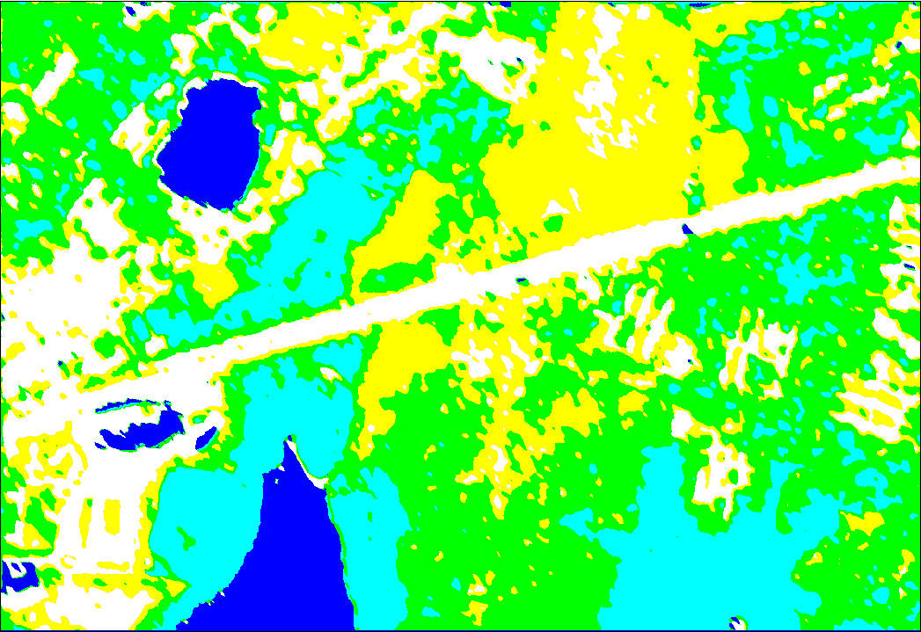
Implementation

Slide 6




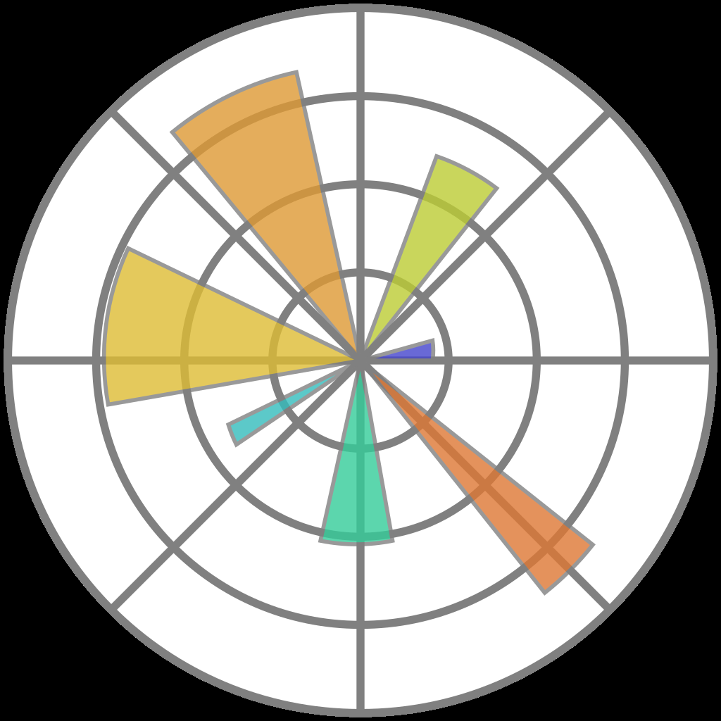



Dependencies
GDAL
NUMPY
PANDAS
MATPLOTLIB
NUMBA (CUDA TOOLKIT)
PyQt 4

Slide 7
Implementation
Programmed in Python 3.5
Three-part code
1. Data input, processing
2. Maximum Likelihood (CUDA Python using Numba)
3. Relaxation Labelling (CUDA Python using Numba)

Slide 8
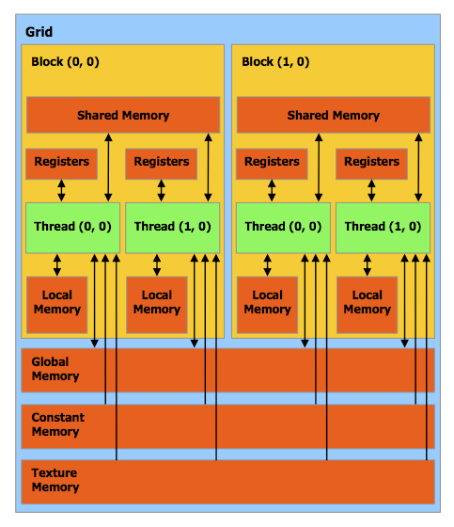
GPU ACCELERATION

Slide 9
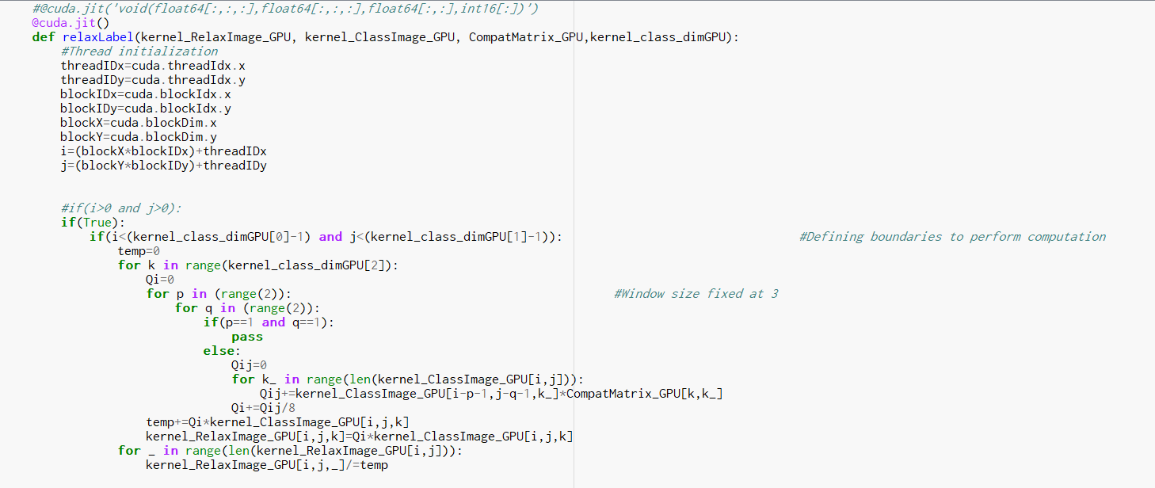
GPU Acceleration

Slide 10
DEMONSTRATION
Fasten Your Seatbelts!

Slide 11
THANK YOU
Acknowlegments:
Prof BK Mohan
ASIP Teaching Assistant, Arun
tutorialspoint.com
NVIDIA development tools
stackoverflow.com

